Slide 3
3-1 Discrete Random Variables

Slide 4
3-1 Discrete Random Variables
Example 3-1

Slide 5
3-2 Probability Distributions and Probability Mass Functions
Figure 3-1 Probability distribution for bits in error.

Slide 6
3-2 Probability Distributions and Probability Mass Functions
Definition

Slide 7
3-3 Cumulative Distribution Functions
Definition

Slide 8
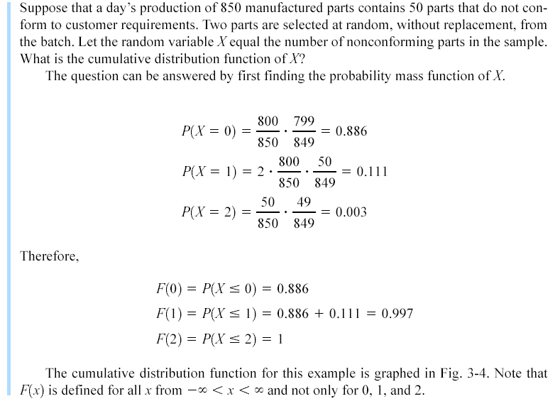
Example 3-8

Slide 9
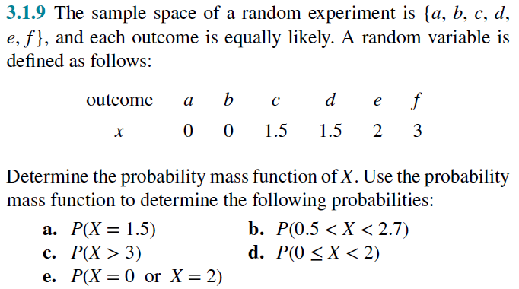

Slide 10
Example 3-8
Figure 3-4 Cumulative distribution function for Example 3-8.

Slide 11
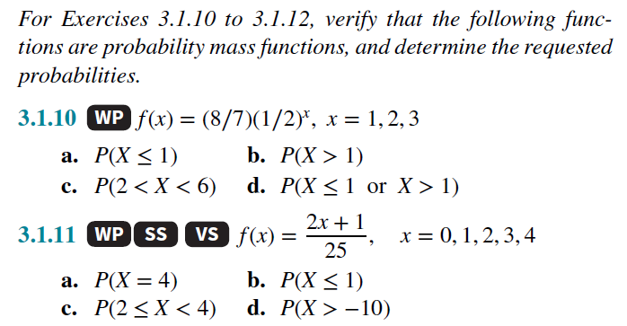

Slide 12
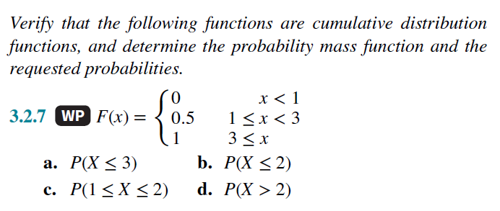

Slide 13
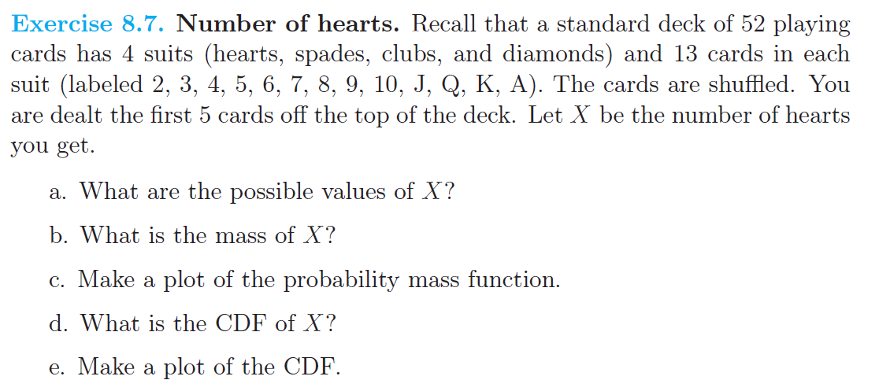

Slide 14
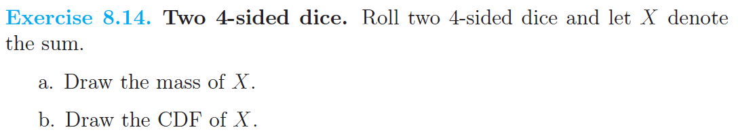

Slide 15
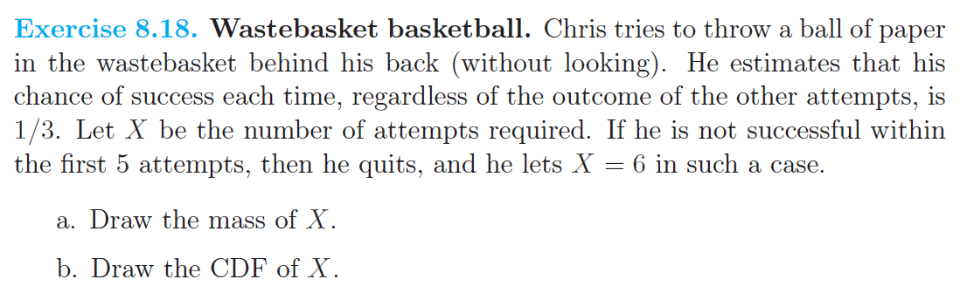

Slide 16
3-4 Mean and Variance of a Discrete Random Variable
Definition

Slide 17
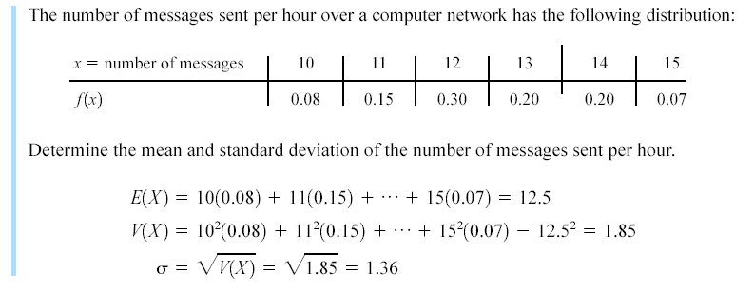
Example 3-11

Slide 18
3-4 Mean and Variance of a Discrete Random Variable
Expected Value of a Function of a Discrete Random Variable

Slide 19
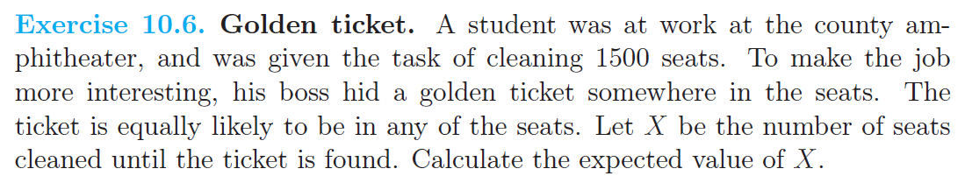

Slide 20
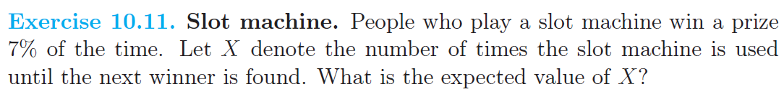

Slide 21
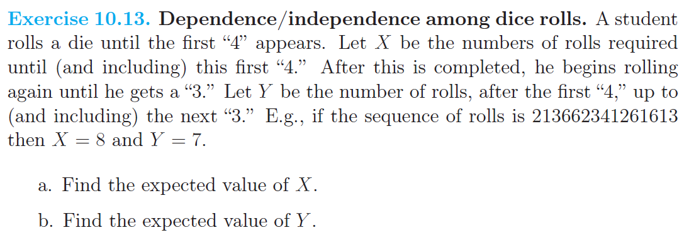

Slide 22
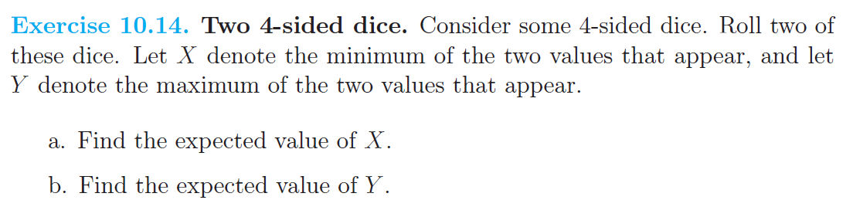

Slide 25
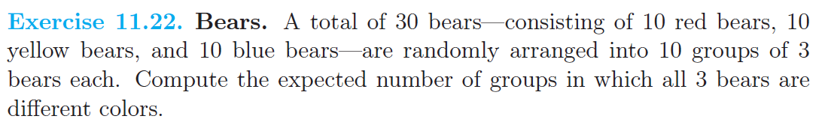

Slide 26
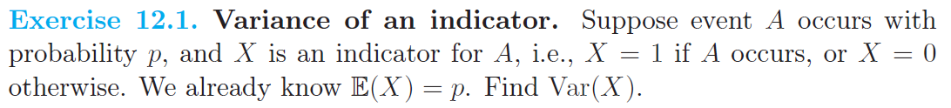

Slide 27
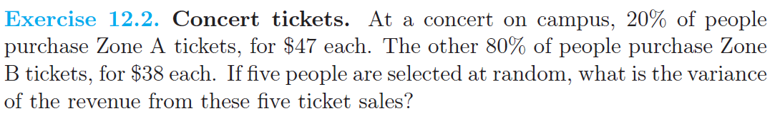

Slide 28
